Slide 1
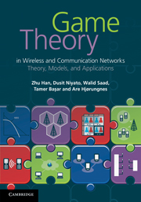
Game Theory in Wireless and Communication Networks: Theory, Models, and Applications
Lecture 1
Noncooperative Games
Zhu Han, Dusit Niyato, Walid Saad,
Tamer Basar, and Are Hjorungnes

Slide 2
Overview of the Lecture Notes
Introduction to Game Theory: Lecture 1, book 1
Non-cooperative Games: Lecture 1, Chapter 3, book 1
Bayesian Games: Lecture 2, Chapter 4, book 1
Differential Games: Lecture 3, Chapter 5, book 1
Evolutionary Games: Lecture 4, Chapter 6, book 1
Cooperative Games: Lecture 5, Chapter 7, book 1
Auction Theory: Lecture 6, Chapter 8, book 1
Matching Game: Lecture 7, book 2
Contract Theory, Lecture 8, book 2
Stochastic Game, Lecture 9, book 2
Learning in Game, Lecture 10, book 2
Equilibrium Programming with Equilibrium Constraint, Lecture 11, book 2
Mean Field Game, Lecture 12, book 2
Zero Determinant Strategy, Lecture 13, book 2
Network Economy, Lecture 14, book 2
Game in Machine Learning, Lecture 15, book 2
[<number>]

Slide 3
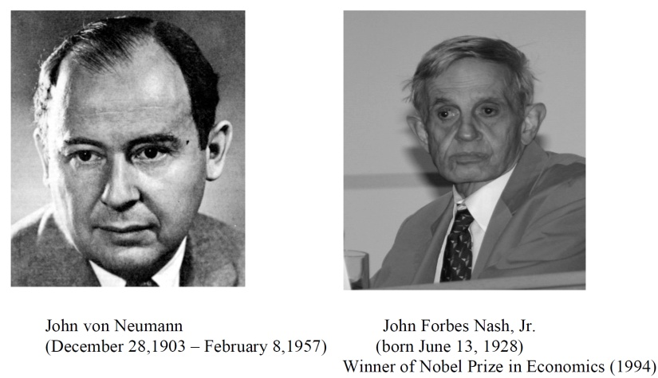

History of Game Theory
John von Neuman (1903-1957) co-authored, Theory of Games and Economic Behavior, with Oskar Morgenstern in 1940s, establishing game theory as a field
John Nash (1928- ) developed a key concept of game theory (Nash equilibrium) which initiated many subsequent results and studies
Since 1970s, game-theoretic methods have come to dominate microeconomic theory and other fields
Nobel prizes
  Nobel prize in Economic Sciences 1994 awarded to Nash, Harsanyi (Bayesian games) and Selten (Subgame perfect equilibrium)
  2005, Auman and Schelling got the Nobel prize for having enhanced our understanding of cooperation and conflict through game theory
  2007, Leonid Hurwicz, Eric Maskin and Roger Myerson won Nobel Prize for having laid the foundations of mechanism design theory
[<number>]

Slide 4
Introduction
Game Theory: Mathematical models and techniques developed in economics to analyze interactive decision processes, predict the outcomes of interactions, and identify optimal strategies
Game theory techniques were adopted to solve many protocol design issues (e.g., resource allocation, power control, cooperation enforcement) in wireless networks
Difference to control: against other players as well as nature
Fundamental component of game theory is the notion of a game
  A game is described by a set of rational players, the strategies associated with the players, and the payoffs for the players. A rational player has his own interest, and therefore, will act by choosing an available strategy to achieve his interest.
  A player is assumed to be able to evaluate exactly or probabilistically, the outcome or payoff (usually measured by the utility) of the game which depends not only on his action but also on other players’ actions.
[<number>]

Slide 5
Examples: Rich Game Theoretical Approaches
Non-cooperative Static Games (Mandayam and Goodman, 2001)
  Sports: Zero sum game, Boxing: Example of equilibrium
  Virginia tech
Repeated Games (MAD: Nobel prize, 2005)
  Threat of punishment by repeated games (playing multiple times)
  Tit-for-Tat (Infocom, 2003)
Dynamic Games (Basar’s book)
  ODE for state, Optimization utility over time, HJB and dynamic programming
  Evolutional game (Hossain and Dusit’s work)
Stochastic Games (Altman’s work)
Cooperative Games
  Nash Bargaining Solution
  Coalitional Game
Notes:
John Edwards

Slide 6

Auction Theory
Book of Myerson (Nobel Prize 2007), J. Huang, H. Zheng, X. Li

Slide 7



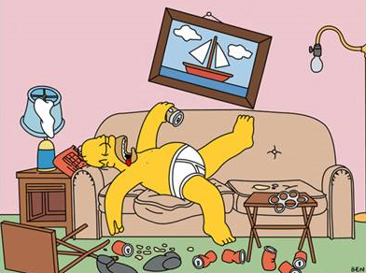
Contract Theoretical: Asymmetry Information
Noble Prize 2014: Adverse Selection and Moral Hazard
Moral Hazard of my PhD student
What my parents thinks I do
What my advisor thinks I do
What I actually do
  When advisor presents
  When advisor on travel

Slide 8








Matching Game: GS algorithm
2012 Nobel Prize in Economic Science.
Geeta, Heiki, Irina, Fran
Adam
Fran
Irina, Fran, Heiki, Geeta
Carl > Adam
Bob
We reach a stable marriage!
Geeta
Geeta, Fran, Heiki, Irina
Carl
Heiki
Irina, Heiki, Geeta, Fran
David > Bob
David
Irina
14

Slide 9
Overview of Non-cooperative Game Theory
Basics
Games in Strategic (Normal) Form
  Dominating Strategy
  Nash Equilibrium
  Mixed Strategy
  Static Continuous-Kernel Games
Dynamic Non-cooperative Games
  Games in Extensive Form
  Repeated Games
  Stochastic Games
Special Games
  Potential Games
  Stackelberg Games
  Correlated Equilibrium
  Supermodular Games
  Wardrop Games
Summary
[<number>]

Slide 10
Basics
Involves a number of players having totally or partially conflicting interests on the outcome of a decision process
Static Game: Players take their actions only once, independently of each other
Dynamic Game: Players have some information about each others' choices, can act more than once
Strategic (Normal) Form: One of the most popular representations
[<number>]

Slide 11
Games in Strategic (Normal) Form
A game in strategic (normal) form is represented by three elements
  A finite set of players, N
  The set of available strategies for player i, S_{i}
  The utility (payoff) function for player i, u_{i}
s = (s_{i} , s_{-i}) is the strategy profile, where s_{i} € S_{i} is the strategy of player i, and s_{-i} the vector of strategies of all players except i
Note that one user’s utility is a function of both this user’s and others’ strategies
Complete Information Game: If all elements of the game are common knowledge
Incomplete Information Game: The players may not know the identities of all other players, their payoffs or their strategies
[<number>]

Slide 12
Matrix Form
Game represented by a matrix
Row represents a strategy for the first (row) player
Column represents the strategies of the second (column) player
Matrix entry, (x, y) where x is the payoff of the first player and y is the payoff of the second player
Example: The Prisoner’s Dilemma
  Two suspects in a crime held for interrogation in separate cells
  If they both stay quiet, each will be convicted with a minor offence and will spend 1 year in prison
  If one and only one of them finks, he will be freed and used as a witness against the other who will spend 4 years in prison
  If both of them fink, each will spend 3 years in prison
[<number>]

Slide 13
Example: The Prisoner’s Dilemma
  Rational Players: The prisoners
  Strategies: Stay Quiet (Q) or Fink (F)
  Solution: What is the Nash equilibrium of the game?
 | P2 Quiet | P2 Fink
P1 Quiet | 1,1 | 4,0
P1 Fink | 0,4 | 3,3

Slide 14
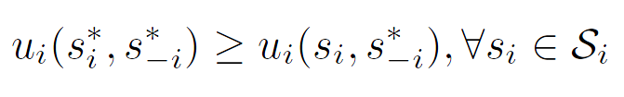
Nash Equilibrium (1)
Dominant Strategy: A player's best strategy, i.e., a strategy that yields the highest utility for the player regardless of what strategies the other players choose
Nash Equilibrium: A strategy profile s* with the property that no player i can do better by choosing a strategy different from s*, given that the strategies of other players j ≠ i remain fixed
In other words, for each player i with payoff function u_{i} ,
No player can improve its payoff by unilaterally changing its strategy, given that the other players' strategies remain fixed
[<number>]

Slide 15
Nash Equilibrium (2)
Does the Nash equilibrium always exist?
Is it efficient?
Pareto Optimality: A measure of efficiency
  A payoff vector x is Pareto optimal if there does not exist any payoff vector y such that
  y ≥ x
  with at least one strict inequality for an element y_{i}
In some references a strategy profile s that achieves a Pareto optimal payoff distribution can sometimes be referred to as a Pareto optimal strategy
[<number>]

Slide 16
The Price of Anarchy
Centralized System: Given a global knowledge of the parameters, one seeks to find the social optimum
  Efficient but often unfair
Decentralized System: When there is non-cooperation and competition among the players, one operating point of interest is the Nash equilibrium
  Inefficient but stable from the players’ perspective
The Price of Anarchy (PoA): The ratio of the cost (or utility) function at social optimum with respect to the equilibrium case
  Measures the price of not having a central coordination in the system
  PoA is, loosely, a measure of the loss incurred by having a distributed system!
[<number>]

Slide 17
Example: The Prisoner’s Dilemma
The Price of Anarchy is 1/3
 | P2 Quiet | P2 Fink
P1 Quiet | 1,1 | 4,0
P1 Fink | 0,4 | 3,3
Pareto optimal
(recall we’re minimizing)
Nash equilibrium

Slide 18
Example: Battle of Sexes
Multiple Nash equilibriums
 | Opera | Football
Opera | 2,3 | 0,0
Football | 0,0 | 3,2
Nash equilibrium
Nash equilibrium

Slide 19
Pure vs. Mixed Strategies
So far we assumed that the players make deterministic choices from their strategy spaces
Pure Strategies: If a player i selects a strategy out of its strategy set S_{i}, in a deterministic manner (with probability 1)
Mixed Strategies: Players select a probability distribution over their set of pure strategies
Nash 1950
  Every finite non-cooperative game in strategic form has a mixed strategy Nash equilibrium
[<number>]

Slide 20
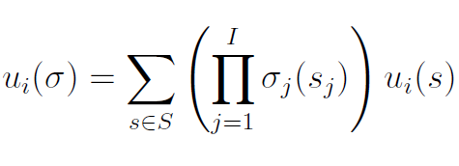

Mixed Nash Equilibrium
Define σ_{i} as a probability mass function over S_{i}, the set of actions of player i
When working with mixed strategies, each player i aims to maximize its expected payoff
A mixed strategy profile σ* is a Mixed strategy Nash equilibrium, if for each player i, we have
[<number>]

Slide 21
Example: Battle of Sexes
 | Opera | Football
Opera | 2,3 | 0,0
Football | 0,0 | 3,2
Husband picks Opera with probability p , wife picks Opera with probability q
Expected payoff for husband picking Opera: 2q
Expected payoff for husband picking Football: 3(1-q)
At mixed NE, the expected payoff at a strategy is equal to that at another strategy (otherwise, one would use a pure NE)
Mixed NE -> Husband: (2/5,3/5) Wife: (3/5,2/5)
Expected payoffs (6/5,6/5)

Slide 22
Algorithms for Finding the NE
For a general N-player game, finding the set of NEs is not possible in polynomial time!
    Unless the game has a certain structure
Some existing algorithms
  Fictitious play (based on empirical probabilities)
  Iterative algorithms (can converge for certain classes of games)
  Best response algorithms
    Popular in some games (continuous kernel games for example)
  Useful reference
    D. Fundenberg and D. Levine, The theory of learning in games, the MIT press, 1998.
[<number>]

Slide 23


Static Continuous-Kernel Game
Action (strategy) sets have uncountably many elements
  For example, strategies are intervals
Similar to the definitions before
  Best response
  Nash equilibrium
[<number>]

Slide 24

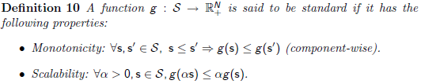

Example: Power Control Game
Interference channel SINR
[<number>]

Slide 25
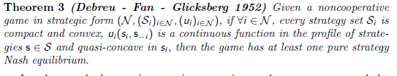
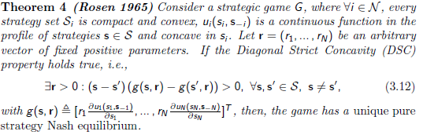
Guidance to Design Utility Function
Existence and uniqueness of Nash equilibrium depend on the utility function design
  Shows the existence of pure strategy Nash equilibria
  Shows the existence of a unique pure strategy Nash equilibrium
[<number>]

Slide 26
Overview of Non-Cooperative Game Theory
Basics
Games in Strategic (Normal) Form
  Dominating Strategy
  Nash Equilibrium
  Mixed Strategy
  Static Continuous-Kernel Games
Dynamic Non-cooperative Games
  Games in Extensive Form
  Repeated Games
  Stochastic Games
Special Games
  Potential Games
  Stackelberg Games
  Correlated Equilibrium
  Supermodular Games
  Wardrop Games
Summary
[<number>]

Slide 27
Games in Extensive Form (1)
In dynamic games, the notion of time and information is important
  The strategic form cannot capture this notion
  We need a new game form to visualize a game
Sequential Games: A major class of dynamic games in which players take their decisions in a certain pre-defined order
  Perfect Information: Only one player moves at a time and each player knows every action of the players that moved before it at every point of the game
  Imperfect Information: Some of the players do not know all the previous choices of the other players
In extensive form, a game is represented with a game tree
  Provides not only a representation of the players, payoffs, and their actions, but also a representation of the order of moves (or sequence) and the information sets
[<number>]

Slide 28
Games in Extensive Form (2)
Game Tree:
  Nodes: Points at which players can take actions. Each node is labeled so as to identify who is making the decision.
    Initial (or root) node: The first decision to be made by one of the players.
    Terminal node: Every set of vertices from the first node through the tree arrives at this node, representing an end to the game. Each terminal node is labeled with the payoffs earned by each player.
  Edges: Nodes are connected by edges, which represent the moves that may be taken by a player present at a certain node.
  Information Sets: A number of nodes enclosed by dotted lines which represent the information available for the player at the time of play.
    Perfect information game: Every information set contains exactly one node since each player knows exactly all the information.
    Imperfect information game: There exists at least one information set containing more than one node.
  Stage: One level of the tree.
  History: Sequence of actions that were taken up to the considered stage.
[<number>]

Slide 29
Example: The Prisoner’s Dilemma
(-5,-5)
1
2
Confess
Confess
Quiet
(0,-10)
Confess
(-10,0)
Quiet
Chess, Go, etc.
Quiet
(-2,-2)
[<number>]

Slide 30
Games in Extensive Form (3)
Normal form gives only the minimum amount of information necessary to describe a game
The extensive form gives additional details about the game
  The timing of the decisions to be made and the amount of information available to each player when each decision has to be made
For every extensive form game, there is one and only one corresponding normal form game
For every normal form game, there are, in general, several corresponding extensive form games
Every finite extensive form game of perfect information has a pure strategy Nash equilibrium
[<number>]

Slide 31
Subgame
A subgame of a dynamic noncooperative game consists of a single node in the extensive form representation of the game
  The game tree, and all of its successors down to the terminal nodes
The information sets and payoffs of a subgame are inherited from the original game
Moreover, the strategies of the players are restricted to the history of actions in the subgame
[<number>]

Slide 32
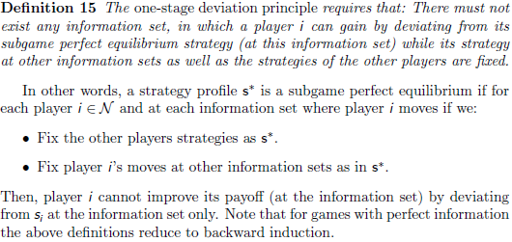
Subgame Perfect Equilibrium
Backward induction is a useful method to find equilibria in a dynamic game (in extensive form) with perfect information.
[<number>]

Slide 33
Finding Subgame Perfect Equilibrium
Steps:
  Pick a subgame that does not contain any other subgame.
  Compute a Nash equilibrium of this subgame.
  Assign the payoff vector associated with this equilibrium to the starting node, and eliminate the subgame.
  Iterate this procedure until a move is assigned at every contingency, when there remains no subgame to eliminate.
Nash equilibrium is not necessarily a subgame perfect equilibrium.
[<number>]

Slide 34
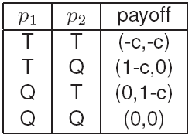
Example: Sequential Multiple Access Game
A basic technique in CSMA/CA protocol
The two devices p1 and p2 are not perfectly synchronized
  p1 decides to transmit or not
  p2 observes p1 before making his own move
The strategy of p1 is to Transmit (T) or to be Quiet (Q)
How many pure Nash equilibria do we have?
H. W. Kuhn, ”Extensive Games and the
problem of information”, Contributions to the
Theory of Games II, 1953.
Theorem (Kuhn, 1953): Every finite extensive form game of perfect information has a pure strategy Nash equilibrium.
[<number>]

Slide 35
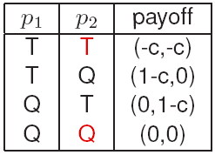
Backward Induction for Sequential Multiple Access Game
How do we solve the game?
If player p2 plays the strategy T then the best response of player p1 is to play Q.
However, T is not the best strategy of player p2 if player p1 chooses T.
We can eliminate some possibilities by backward induction.
Player p2 knows that he has the last move.
Given all the best moves of p2, player p1
calculates his best moves as well.
It turns out that the backward induction
solution is the historical move (T) then (Q).
[<number>]

Slide 36
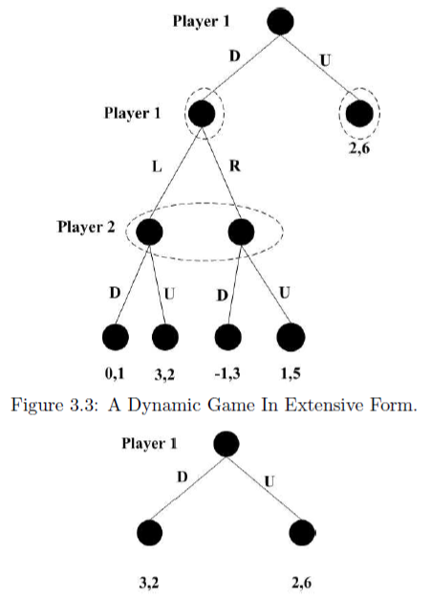
Example: Without Backward Induction
Imperfect information; backward induction not possible
  Consider the two subgames: The subgame that starts after Player 1 plays D and the subgame which is the game itself
  Consider the first subgame and find NE
  Clearly only one NE: (L,U), Payoff: (3, 2)
  Game tree reduced to the second one
  Clearly player 1 would choose D
  Subgame perfect equilibrium:
  Player 1 picks D at stage 1
  L at stage 2
  Player 2 always picks U
[<number>]

Slide 37

Repeated Game Basics
Static noncooperative strategic game that is repeated over time
Average utility (power, in our case) over time
  Discounting factor, β
Folk Theorem:
  A feasible outcome can be obtained through a repeated game
  In the long run, the players, although acting noncooperatively, might choose a cooperative behavior so as to obtain a payoff that is better than the minmax value.
Enforcing cooperation by punishment: Trigger Strategies
  Tit-for-Tat: Player responds by defecting, once the opponent defects
  Cartel Maintenance: Provide enough threat to greedy players
Approach: Cooperate initially, detect the outcome of the game
  If better than a threshold, play cooperation the next time. Else, play non-cooperation for a period T, and then cooperate.
[<number>]

Slide 38
Stochastic Game Basics
A repeated game with stochastic (probabilistic) transitions between the different states of the game.
A dynamic game composed of a number of stages, and where, at the beginning of each stage the game, is in some state.
In this state, the players select their actions and each player receives a payoff that depends on the current state and the chosen actions.
The game then moves to a new random state whose distribution depends on the previous state and the actions chosen by the players.
The procedure is repeated at the new state and the game continues for a finite or infinite number of stages.
The total payoff to a player is often taken to be the discounted sum of the stage payoffs (similar to the discounted sum of repeated games) or the limit inferior of the averages of the stage payoffs.
Notice that 1-state stochastic game is equal to (infinitely) repeated game, and 1-agent stochastic game is equal to Markov Decision Process (MDP).
Partial observed MDP is a widely used model for wireless networking.
Bellman equation
[<number>]

Slide 39
Overview of Non-Cooperative Game Theory
Basics
Games in Strategic (Normal) Form
  Dominating Strategy
  Nash Equilibrium
  Mixed Strategy
  Static Continuous-Kernel Games
Dynamic Non-cooperative Games
  Games in Extensive Form
  Repeated Games
  Stochastic Games
Special Games
  Potential Games
  Stackelberg Games
  Correlated Equilibrium
  Supermodular Games
  Wardrop Games
Summary
[<number>]

Slide 40
Potential Games (1)
A special class of noncooperative games having a special structure
Non-zero sum games in which the determination of a Nash equilibrium can be equivalently posed as a maximization of a single function, called the potential function
The potential function is a useful tool to analyze equilibrium properties of games
  Since the objectives and goals of all players are mapped into one function
Potential games are characterized by their simplicity and the existence of a Nash equilibrium solution
Often, potential games are useful when dealing with continuous-kernel games
[<number>]

Slide 41
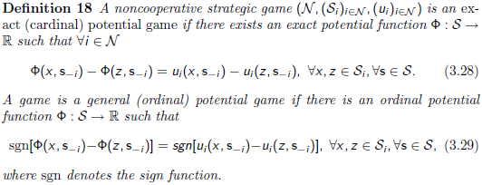
Potential Games (2)
Formally,
In exact potential games, the difference in individual utilities has the same value as the difference in potential function values
  Achieved by each player when changing its strategy unilaterally
In ordinal potential games, only the signs of the differences have to be the same
[<number>]

Slide 42

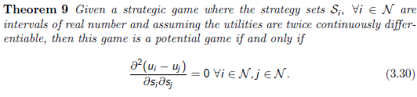
Potential Games (3)
The Nash equilibrium is unique
  When the strategy set S is compact and convex and the potential function is a continuously differentiable function on the interior of S and strictly concave on S
[<number>]

Slide 43

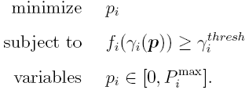
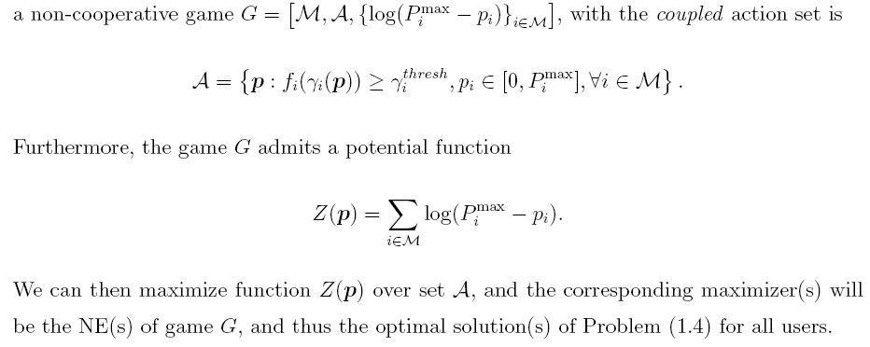
Example: Single Cell CDMA Network
Consider a single-cell CDMA network, M users
SINR
Optimization
[<number>]

Slide 44
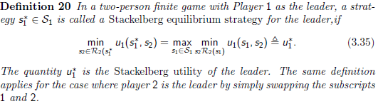
Stackelberg Games (1)
Hierarchy among the players exists
  The player that imposes its own strategy upon others is called the leader
  The other players who react to the leader's strategy are called followers
Every two-person finite game admits a Stackelberg strategy for the leader
Whenever the follower has a single optimal response for every strategy of the leader, then the leader can, at the Stackelberg solution, perform at least as good as at the Nash equilibrium
[<number>]

Slide 45
Stackelberg Games (2)
Stackelberg games are not limited to the single-leader single-follower case
In a single-leader multi-follower case, the Stackelberg equilibrium is basically composed of an optimal policy for the leader with respect to a Nash equilibrium of the followers
  It is often desirable to have a unique Nash equilibrium for the followers game, so as to make the Stackelberg solution tractable
  Example application: Pricing for Internet Service Providers
Multi-leader multi-follower Stackelberg games
  At the Stackelberg equilibrium, both leaders and followers are in a Nash equilibrium (the Nash equilibria are correlated)
  Hard to solve when the followers game has many equilibria
[<number>]

Slide 46


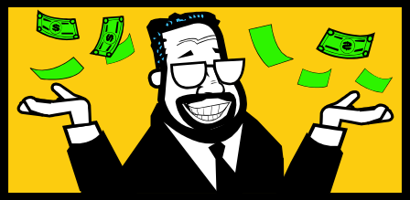


Example: Buyer/Seller Game (Two Level)
Buyer/Seller (Leader/Follower) Game
  Sender (buyer) buying the services from the relays to improve its performance, such as the transmission rate
  Relays (sellers) selling service, such as power, by setting prices
  Tradeoffs: Price too high, sender buying from others; price too low, profit low; sender decides to buy whose and how much to spend
  Procedures: Convergence to the optimal equilibrium
  Example: Power Control and Relay Section for Cooperative Transmission
$1000
Per Power
$800
Per Power
[<number>]

Slide 47
Example: Access Game
The technique of backward induction helps to identify the Stackelberg equilibrium
  It helps reducing the strategy space but becomes very complex for longer extensive form games
Definition: The strategy profile s is a Stackelberg equilibrium with player p1 as the leader and player p2 as the follower
  If player p1 maximizes his payoff subject to the constraint that player p2 chooses according to his best response function.
Application:
  If p1 chooses T then the best response of p2 is to
  play Q (payoff of 1-c)
  If p1 chooses Q, then the best response of p2 is T
  (payoff of 0 for p1)
  p1 will therefore choose T which is the Stackelberg equilibria
[<number>]

Slide 48
Correlated Equilibrium (1)
Beyond the Nash equilibrium, one can seek a more generalized solution concept for noncooperative games: the correlated equilibrium
A concept suited for scenarios that involve a decision process in between non-cooperation and cooperation
A correlated equilibrium is, in essence, a generalization of the Nash equilibrium
  Requires an arbitrator who can send (private or public) signals to the players
  These signals allow the players to coordinate their actions and perform joint randomization over strategies
The arbitrator can be a virtual entity (the players can agree on the first word they hear on the radio) and generate signals that do not depend on the system
[<number>]

Slide 49
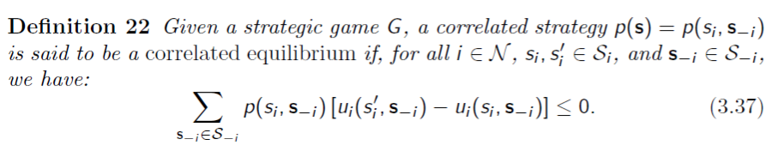
Correlated Equilibrium (2)
A multi-strategy obtained using the signals is a set of strategies
  One strategy for each player which may depend on all the information available to the player including the signal it receives
It is said to be a correlated equilibrium if no player has an incentive to deviate unilaterally from its part of the multi-strategy
A special type of “deviation” can be of course to ignore the signals!
[<number>]

Slide 50
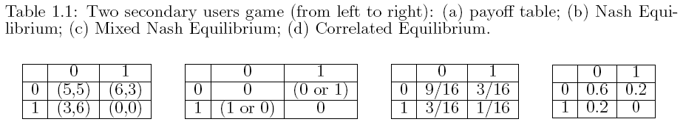
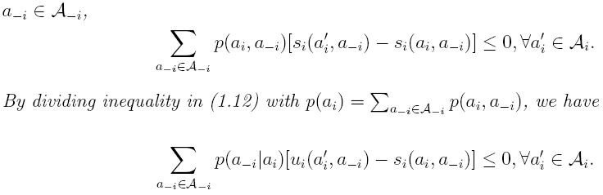
Example: Correlated Equilibrium
Each user to consider the joint distribution of users' actions
Multiple access game
  Distributive Opportunistic Spectrum Access for Cognitive Radio using Correlated Equilibrium and No-regret Learning, WCNC 2007
[<number>]

Slide 51
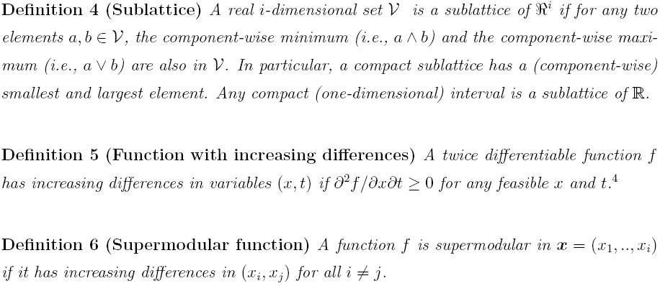
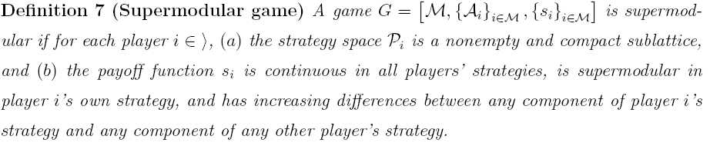
Supermodular Games (1)
Strategic complementarities: If a player chooses a higher action, the other players are better off if they also take a higher action
Nice properties: Existence and achievability of NE
[<number>]

Slide 52
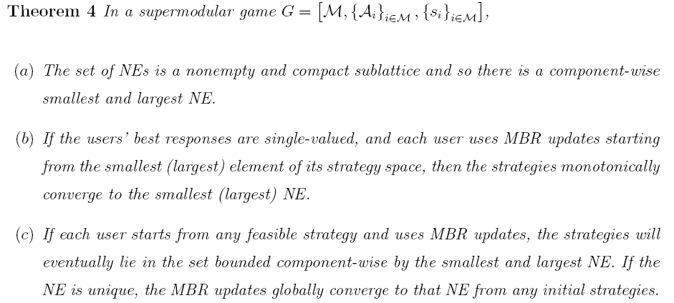
Supermodular Games (2)
Power control in CDMA networks can often be captured using a supermodular game model
  Dog barking effect
[<number>]

Slide 53
Wardrop Equilibrium (1)
Wardrop (1952) postulated that users in a network game select routes of minimal length.
  In the asymptotic regime, the game becomes a non-atomic one, in which the impact of a single player on the others is negligible.
In the networking game context, the related solution concept is often called Wardrop equilibrium and is often much easier to compute than the original Nash equilibrium.
The Wardrop equilibrium state can be seen as a state where no arbitrary small fraction of the traffic assigned to some path can benefit from unilaterally deviating to another path.
Useful for games dealing with network flows and in which there exists a large population of players.
  A. Haurie and P. Marcotte, “On the Relationship between Nash-Cournot and Wardrop Equilibria,” Networks, vol. 15, pp. 295-308, 1985.
[<number>]

Slide 54
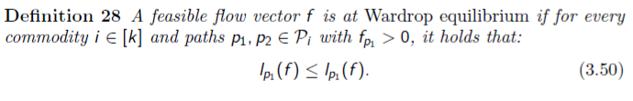
Wardrop Equilibrium (2)
In the Wardrop equilibrium, a flow vector is considered stable when no fraction of the flow can improve its sustained latency by moving unilaterally to another path.
  Wardrop's first principle: All used paths from a source to a destination have equal mean latencies.
  Wardrop's second principle: Any unused path from a source to a destination has greater potential mean latency than that along the used paths.
Mainly used in flow control and routing in communication networks, in dense ad hoc networks, as well as routing in wireless networks.
[<number>]

Slide 55
Summary
Non-cooperative game is the most basic form of the game theory
How to carefully design the utility function
  Basic components
  Convergence and uniqueness
Extensive form
Different types of games and their examples
Price of Anarchy
  Further reading: Pricing to improve the performance
  Cem Saraydar and Narayan B. Mandayam and David J. Goodman Efficient Power Control via Pricing in Wireless Data Networks IEEE Trans. on Communications, vol. 50, No. 2, pp. 291-303, February 2002
[<number>]

